Slide 1
MUTUAL FUNDS
9.24.XX

Slide 2
MUTUAL FUNDS
INTRODUCTION
TYPES OF MUTUAL FUNDS
ADVANTAGES OF MUTUAL FUNDS
MYTHs ABOUT MUTUAL FUNDS
FACTS ABOUT MUTUAL FUNDS

Slide 3
INTRODUCTION
WHAT IS MUTUAL FUNDS
A mutual fund is a pool of money managed by a professional Fund Manager.
It is a trust that collects money from a number of investors who share a common investment objective and invests the same in equities, bonds, money market instruments and/or other securities. And the income / gains generated from this collective investment is distributed proportionately amongst the investors after deducting applicable expenses and levies, by calculating a scheme’s “Net Asset Value” or NAV. Simply put, the money pooled in by a large number of investors is what makes up a Mutual Fund.

Slide 5
ADVANTAGES OF MUTUAL FUNDS
Diversification:
Mutual funds invest in a wide range of securities, such as stocks, bonds, and other assets, which provides investors with diversification. This means that investors can spread their risk across several investments, reducing the impact of any one investment on their portfolio.
Professional Management:
Mutual funds are managed by professional fund managers who have expertise in selecting investments and managing portfolios. These managers have access to research, information, and analysis that individual investors may not have, which can help to generate higher returns.
Low minimum investment:
Many mutual funds have low minimum investment requirements, making them accessible to investors with limited funds.

Slide 6
Liquidity:
Mutual funds are generally very liquid, which means investors can easily buy and sell shares. This provides investors with flexibility and the ability to quickly access their funds when needed.
Convenience:
Mutual funds are easy to buy and sell, and they offer investors the ability to invest in a range of assets without having to manage each individual investment themselves.
Cost-effective:
Mutual funds can be a cost-effective investment option, as they can provide investors with access to a diversified portfolio at a lower cost than if they were to invest in each asset individually.
Transparency:
Mutual funds are required to provide regular reports and updates to investors, which provides transparency and helps investors make informed decisions about their investments.

Slide 7
MYTHS ABOUT MUTUAL FUNDS
Mutual funds are only for wealthy investors: Many mutual funds have low minimum investment requirements.
Mutual funds are too risky: Mutual funds can offer diversification and professional management, which can help to reduce risk.
Mutual funds are too complicated:
Investors can choose a fund based on their investment goals and risk tolerance.
Mutual funds always outperform the market:
While some mutual funds may outperform the market, not all do
Mutual funds always have high fees:
Investors can choose a fund with lower fees to find the best option for their investment goals.
Mutual funds are not transparent:
Mutual funds are required to provide regular reports and updates to investors, which provides transparency.

Slide 8
WHAT IS AMC?
AMC stands for Asset Management Company.
AMC is a company that manages and overseas the operations of a mutual fund. The AMC also markets and sells mutual fund units to investors and provides investor services such as account statements and customer support.

Slide 9
WHAT IS SIP?
SIP stands for Systematic Investment Plan.
Under a SIP, the investor sets up an automatic transfer from their bank account to the mutual fund on a regular basis (e.g. monthly) and the mutual fund units are purchased at the prevailing market price.
Disciplined investing: With a SIP, investors make regular, consistent investments regardless of the market conditions, which can help them avoid the temptation to time the market and make emotional investment decisions.
Averaging of purchase price: Since investors are investing a fixed amount at regular intervals. This helps to average out the purchase price of the mutual fund units over time.
Compounding of returns: The returns generated by the mutual fund can be reinvested and generate additional returns on the original investment hence SIPs provide investors the opportunity to benefit from the power of compounding.

Slide 10
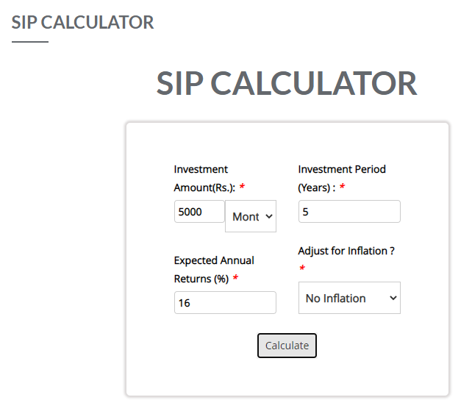
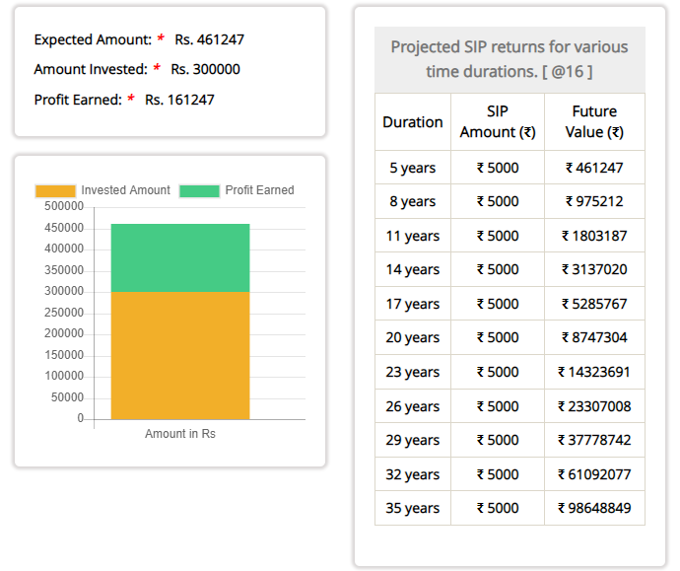
Example of SIP

Slide 11
WHAT IS SWP ?
SWP stands for Systematic Withdrawal Plan, which is a facility offered by mutual funds to investors. In an SWP, the investor can withdraw a fixed amount of money from their mutual fund investments at regular intervals, such as monthly or quarterly. The amount of withdrawal can be a fixed sum or a certain percentage of the investment.
SWP is particularly useful for investors who want to generate a regular income stream from their mutual fund investments. Instead of selling off their units in one go, they can withdraw a fixed amount periodically, thus spreading out the liquidation of their investments over time

Slide 12
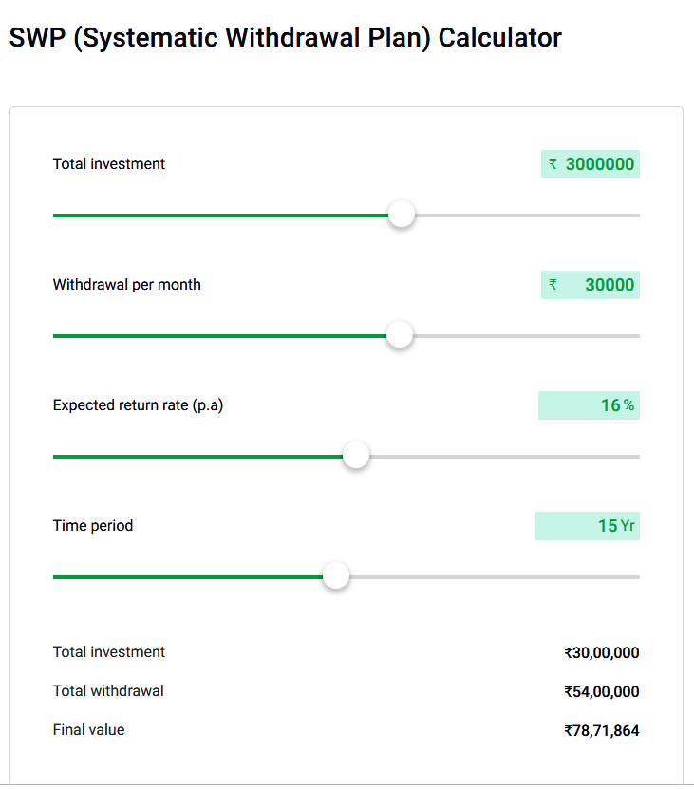
Example of SWP

Slide 13
WHAT IS LUMP SUM?
A lump sum refers to a one-time, lump sum investment made into a mutual fund or other investment product, as opposed to investing smaller amounts of money over time.
Investing a lump sum involves investing a large amount of money at once, which can provide the potential for higher returns in a shorter period of time. However, lump sum investing can also be riskier than investing smaller amounts over time since the entire investment is exposed to market volatility at once.
Investors may choose to invest a lump sum in a mutual fund if they have a large amount of cash available for investment, such as an inheritance or a bonus, or if they believe that the market is currently favorable for investment. However, investors should also consider their investment goals, risk tolerance, and time horizon before deciding whether to invest a lump sum or to use a more gradual approach such as a SIP (Systematic Investment Plan).

Slide 14
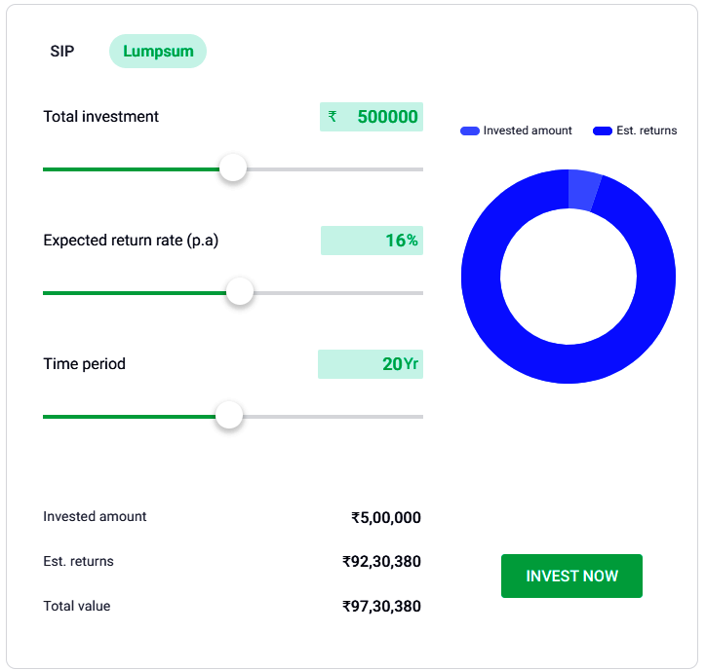
Example of LUMP SUM

Slide 15
WHAT IS NAV?
NAV stands for Net Asset Value, and it represents the per-unit price of a mutual fund. The NAV is calculated by taking the market value of all the assets held by the mutual fund, subtracting any liabilities such as expenses or fees, and then dividing that number by the total number of outstanding units of the fund. The NAV is calculated at the end of each trading day and investors can use it to determine the current price of a mutual fund unit and to track the performance of their investment over time.

Slide 16
MUTUAL FUNDS PROCESS CYCLE

Slide 17
MUTUAL FUNDS SUMMARY
Mutual funds are investment vehicles that pool money from individual investors to purchase securities such as stocks, bonds, and other assets. The mutual fund is managed by a professional investment manager, who invests the pooled money in a diversified portfolio of securities in accordance with the fund's investment objective.
Investors in a mutual fund purchase units of the fund, with the value of the units determined by the Net asset value (NAV) of the fund. The NAV is calculated by taking the market value of all the assets held by the mutual fund, subtracting any liabilities, and then dividing that number by the total number of outstanding units of the fund.
Mutual funds offer several benefits to investors, including diversification, professional management, liquidity, and convenience. However, mutual funds also have risks, such as market risk and investment management risk. Investors should carefully consider their investment goals, risk tolerance, and time horizon before investing in a mutual fund.

Slide 18
THANK YOU
Mind Vista Fund
8445914250
mindvistafund@gmail.com
www.mindvistafund.com

